Slide 1
End-to-end Vision-based Autonomous Driving using Deep Learning
Author
Sergio Paniego Blanco
Supervisor
José María Cañas Plaza
Doctoral Program in Information and Communications Technologies
International Doctoral School
2024
@sergiopaniego
sergio.paniego@urjc.es
https://sergiopaniego.github.io/

Slide 2
Outline
Introduction
State-of-the-art
TrafficSensor
DetectionMetrics
Behavior Metrics
Adding memory
Optimizing DL models
Driving in traffic
Conclusions and future research

Slide 3
Introduction

Slide 4
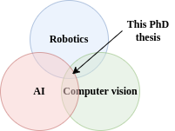
Introduction
Autonomous driving (AD): vehicles that drive safely without human intervention.
Robotics + Artificial Intelligence (AI) + Computer Vision (CV).
Development comes from different sides, specially AI.
Benefits and motivation:
Improved traffic safety (94% of accidents caused by human driver error).
Optimized mobility.
Reduce driver’s stress.
Reduce operative costs.
Reduce pollution.
…
Some examples from AD companies already suggest an advancement in this direction.

Slide 5
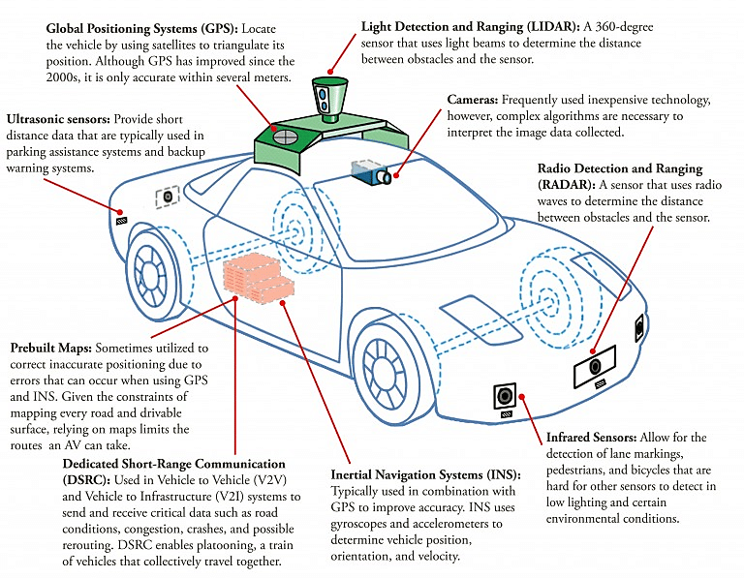
Introduction to AD
Mobile robot in terms of hardware and software.
Sensors like GPS, IMUs, LIDARS, cameras…
Actuators like throttle, brake…
CPUs and GPUs.

Slide 6
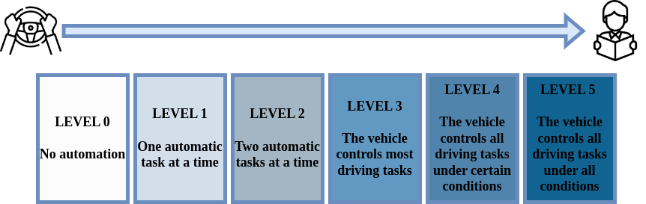
Levels of autonomy

Slide 7
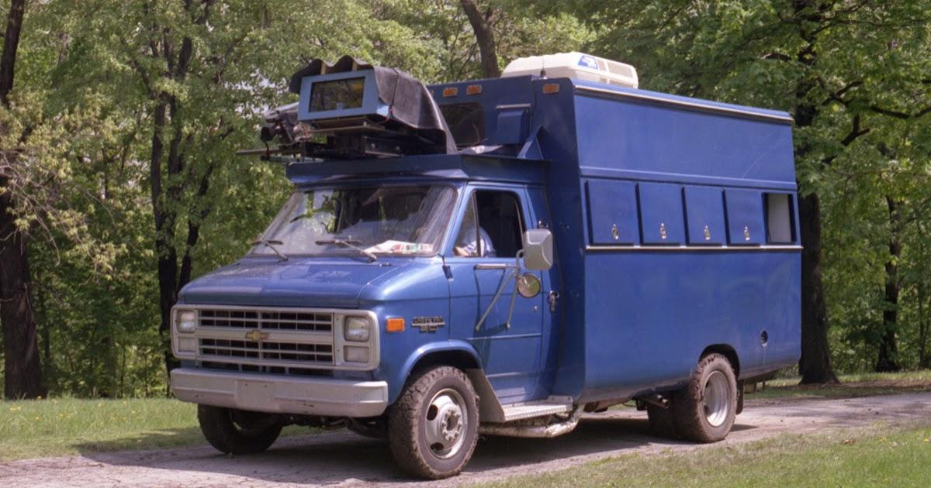
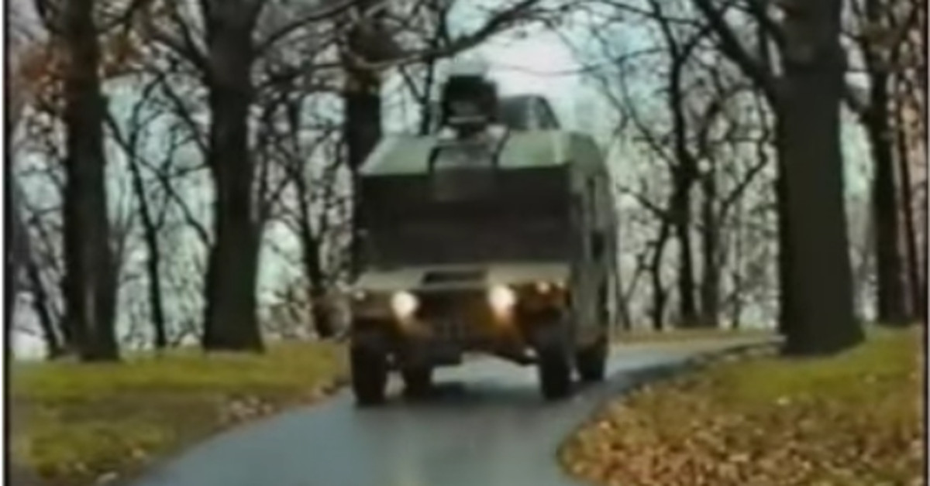
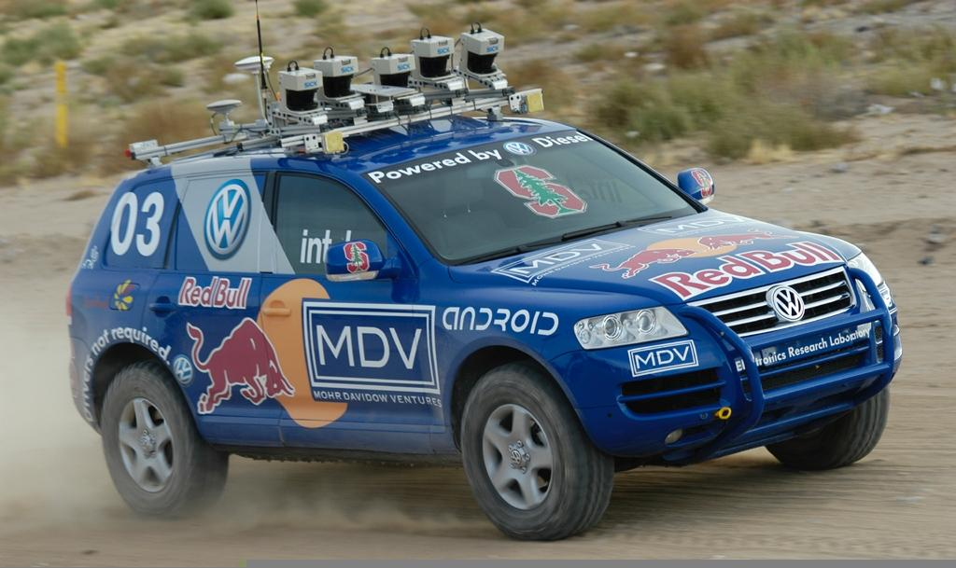
History
First examples in the 80s: Navlab 1 (1986), ALVINN (1989)…
DARPA Grand Challenge (2004) and DARPA Urban Challenge (2007).
Advanced driver-assistance systems (ADAS).

Slide 8
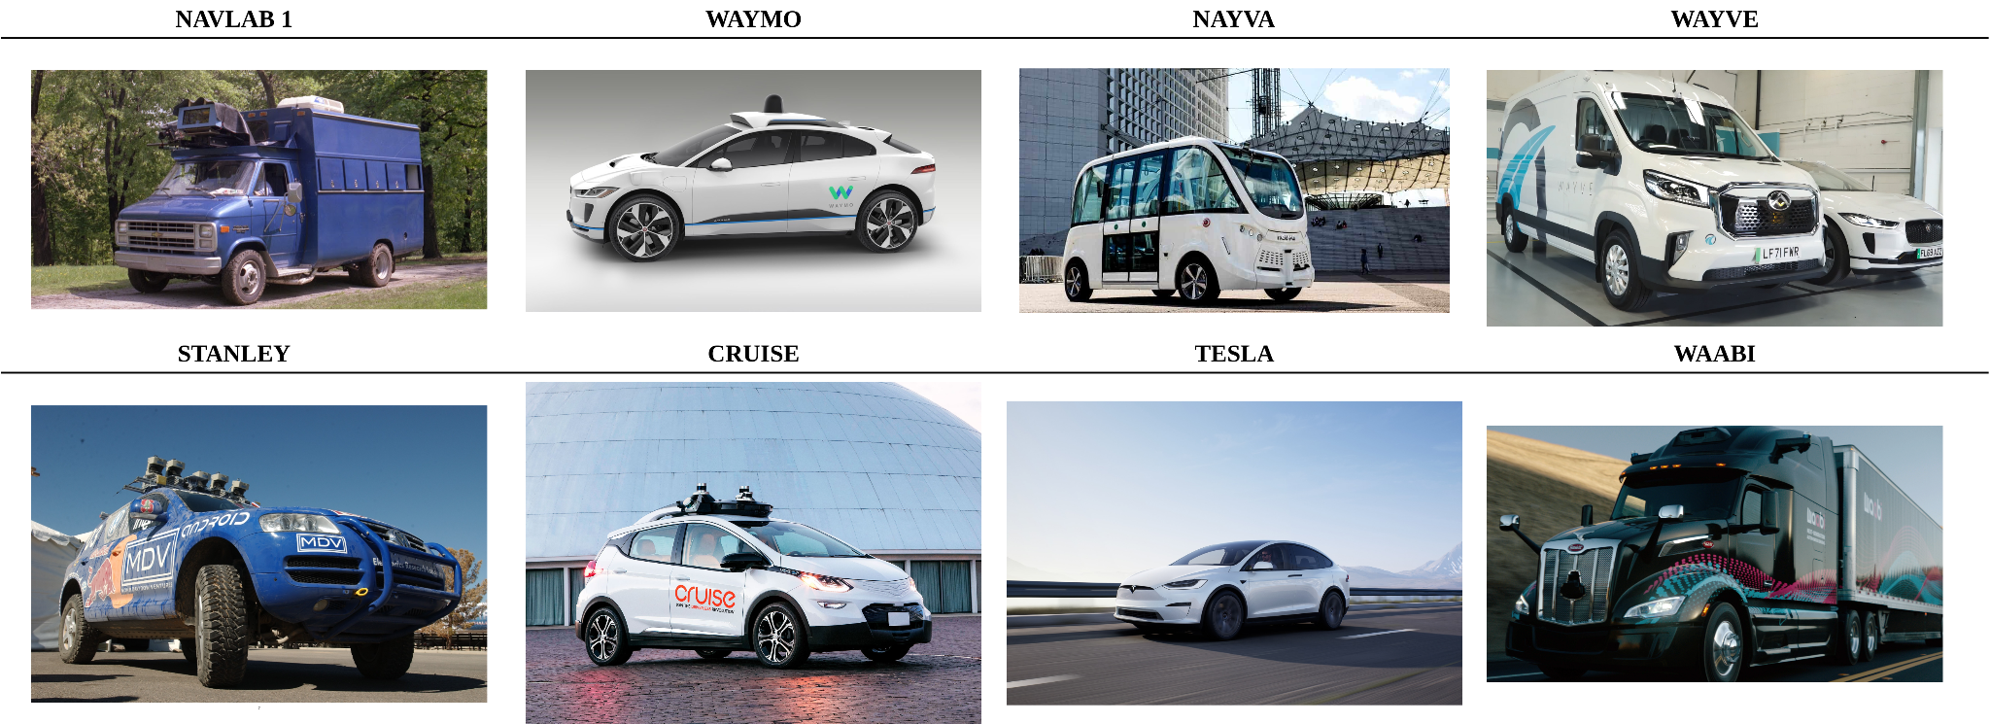
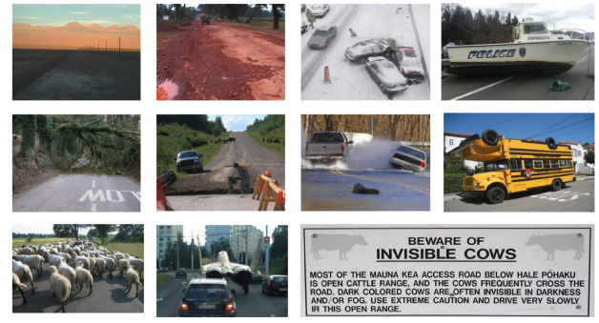
Range of application
Diverse range of environments and weather conditions.
Urban scenarios, roads, highways.
Use of maps.
Vast range of vehicle types.
Robustness is key (high-speed motion and humans passengers).

Slide 9
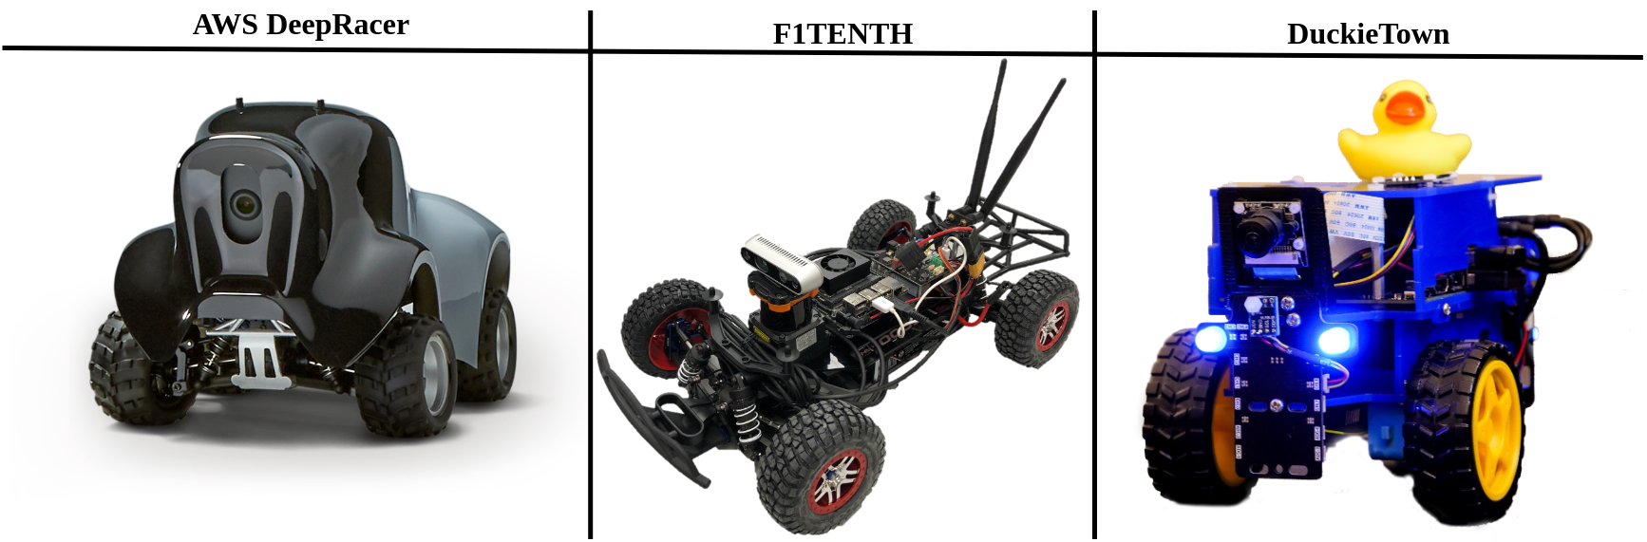
Growing research community
Incremental importance.
Many workshops, tutorials in conferences.
Competitions.

Slide 10

Assessment and metrics
AD includes a broad spectrum of methodologies aimed at evaluating solutions derived from research.
Studying the behavior carefully is crucial for understanding both its strengths and weaknesses.
Massive datasets.
Automatic and massive testing.
Offline vs online.

Slide 11
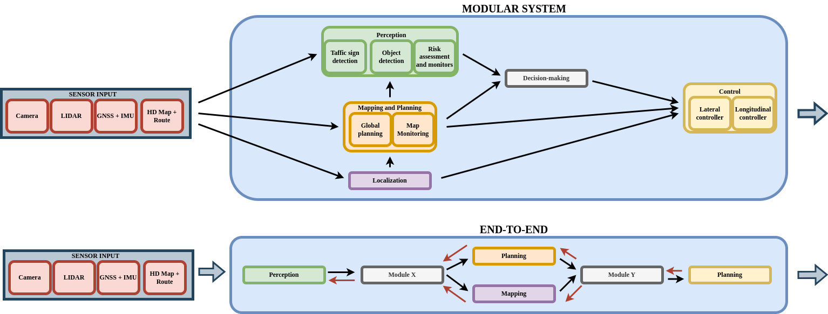
End-to-end and modular approaches
2 main approaches in the development of AD solutions:
Modular.
End-to-end (E2E).
The majority are currently modular but there is a trend towards end-to-end.

Slide 12
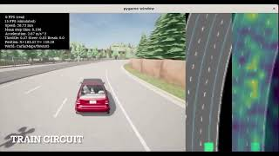
Tasks in an AD system
A multitude of driving tasks are combined into the final AD system.
Autonomous parking, lane following, intersection negotiation…

Slide 13
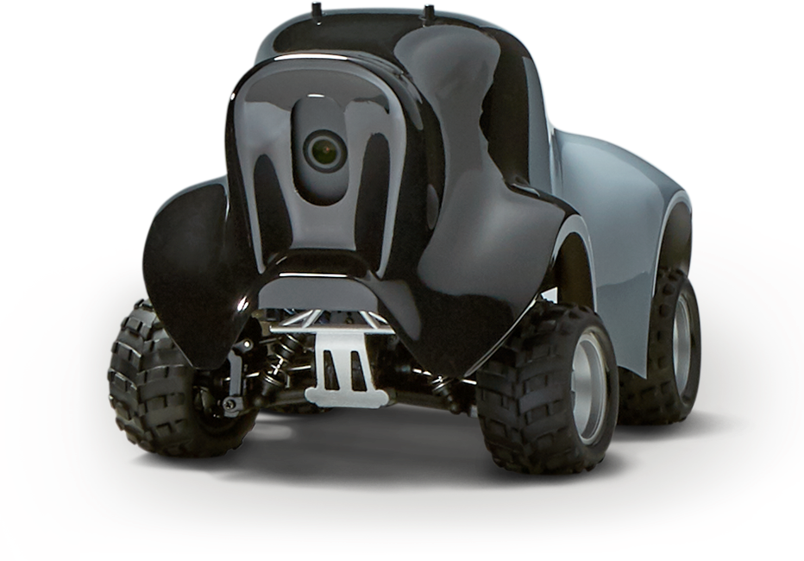
Optimization in AD solutions
In robotics and AD, we need solutions that are fast and reliable.
The performance not only depend on the quality of the decisions but also on their frequency.
Some AD vehicles and robots are equipped with high-performance hardware but there are systems where this is not true.
Solutions must be optimized while upholding stringent safety standards.

Slide 14
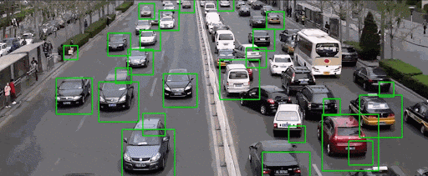
Traffic monitoring using CV
Traffic monitoring plays a pivotal role in urban planning transportation managements, and public safety.

Slide 15
Research goals
Make contributions in the field of vision-based autonomous driving using deep learning, imitation learning and end-to-end models.
A systematic study of the state-of-the-art in AD.
Validate CV in a driving setting generating a traffic monitoring tool.
Generate an object detection assessment software to validate solutions.
Generate an autonomous driving behaviors assessment software to conduct the experiments and generate quantitative data.
Empirical study of the improvements to the basic visual lane following with the addition of visual memory and kinematic input.
Empirical study of model optimization for the controllers of AD vehicles, generating optimized models that improve the system.
Generation of and E2E shallow model capable of driving in traffic based on visual input.

Slide 16
State-of-the-art

Slide 17
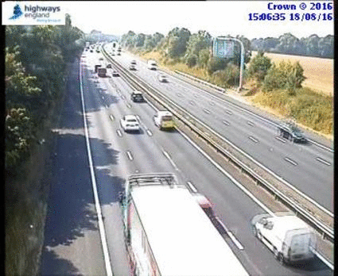
Traffic monitoring
Traffic monitoring is a classic problem within computer vision.
Before deep learning, traffic surveillance using video cameras was significantly limited but this changed with the appearance of this technology.

Slide 18



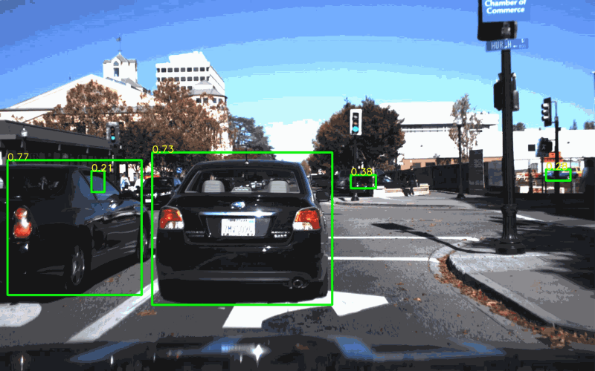
Deep learning object detection, datasets and assessment
Significant popularity lately. Notable advancements.
Part of the perception in autonomous driving systems.
Many datasets are available like COCO, ImageNet, Pascal VOC… and some others specialized.
Each CV tasks includes a specific set of evaluation metrics.
All the current state-of-the art solutions rely on DL.
In object detection, we find examples like Faster R-CNN, SSD, YOLO, DETR, Swin Transformer, DINO…

Slide 19
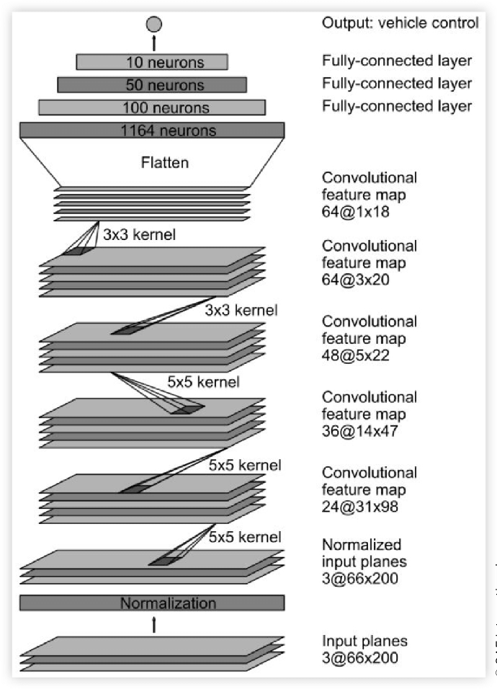
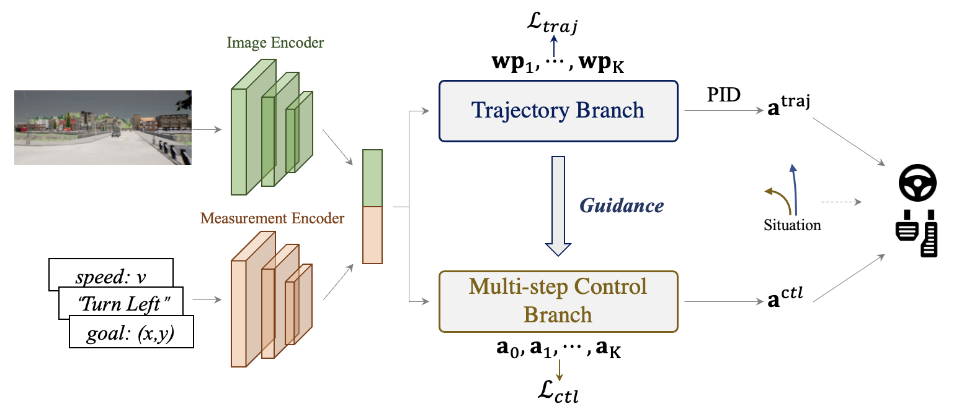
Autonomous driving and imitation learning
AD combines artificial intelligence, robotics, and CV.
Modular vs E2E approach.
Vision-based E2E AD.
PilotNet.
TCP, ReasonNet, NET, Transfuser…

Slide 20
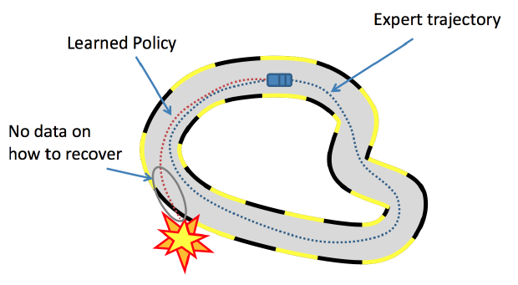
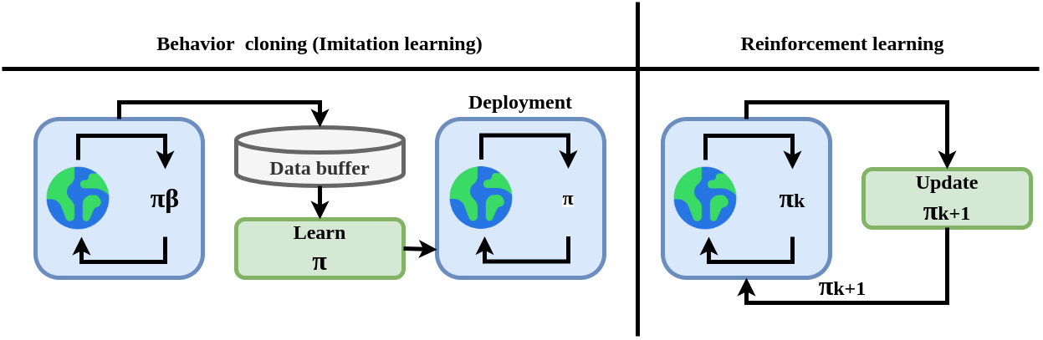
Imitation learning and RL for driving autonomously
Imitation learning (behavior cloning): generating a driving policy learning from expert agent-gathered data.
Reinforcement learning (RL).
Combination of both.

Slide 21
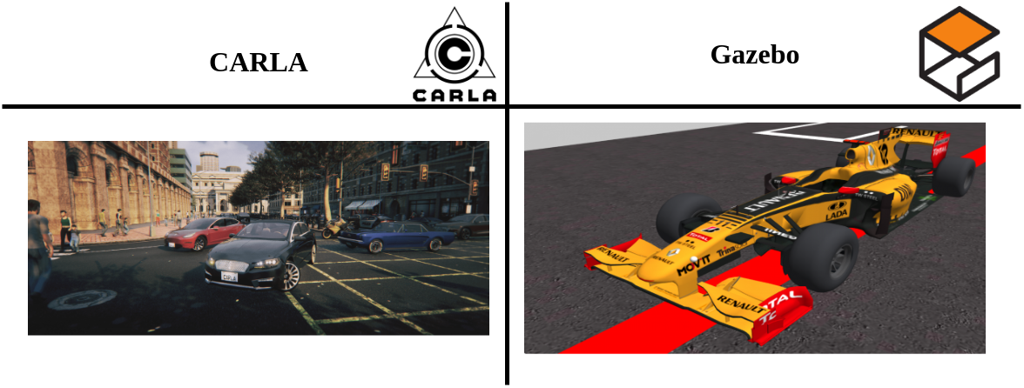
Simulation in AD and assessment. Datasets
In the development and research of robotics systems, simulators are commonly used to generate solutions rather than directly developing in real robotics or vehicles.
A diverse array of simulators for AD are available. SUMO, TORCS, Gazebo, CARLA, DeepDrive, Autoware, proprietary simulators, world generators…

Slide 22
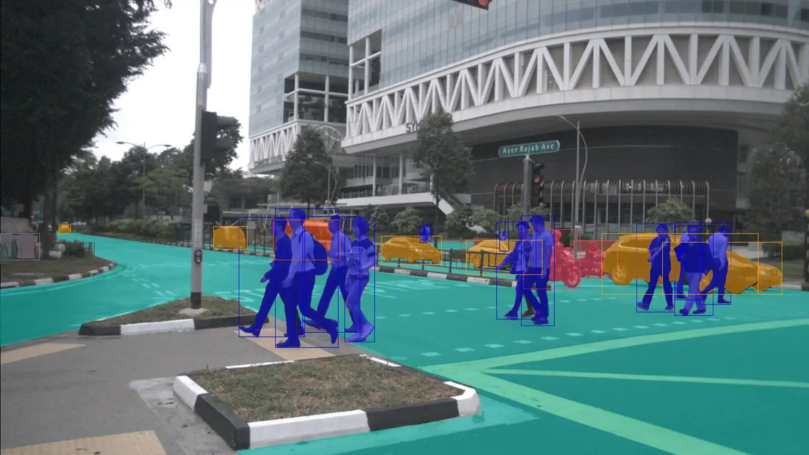
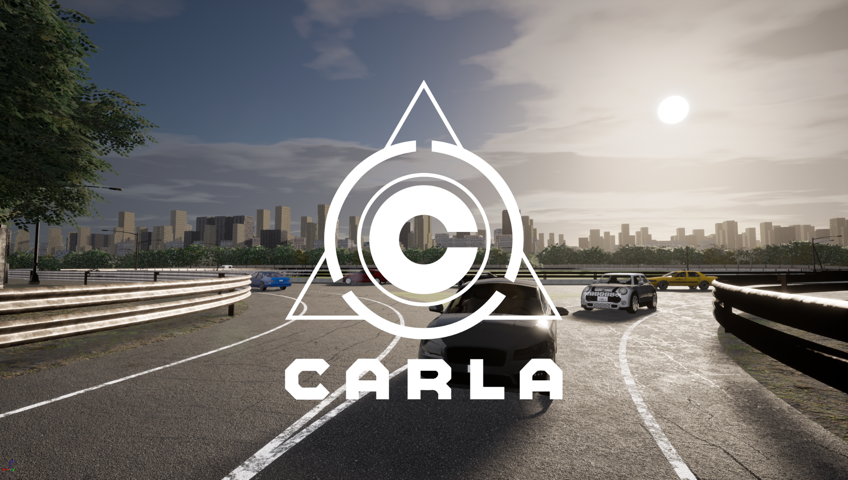
Simulation in AD and assessment. Datasets
In AD development, there are a lot of specialized datasets: nuScenes, BDD100K, KITTI, Cityscapes…
CARLA Leaderboard for the assessment of solutions.
Many different tasks and specific metrics needed.

Slide 23

Memory-based approaches in E2E visual AD
An intriguing avenue of research within the E2E approach involves integrating memory capabilities.
LSTM modules, convLSTMS…
Modified input.

Slide 24
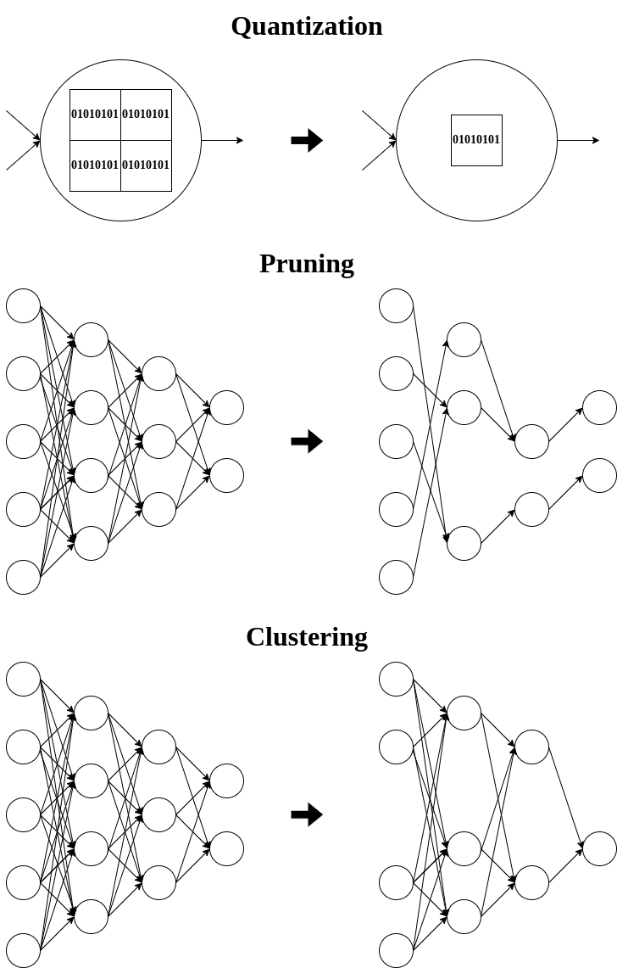


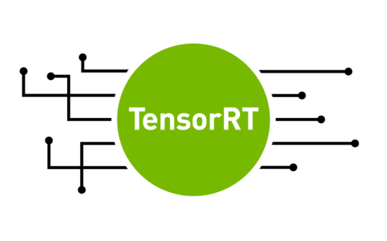
Optimization of deep learning models for autonomous driving
The optimization of deep learning models is key, as previously discussed.
There are an extensive number of optimization techniques:
Quantization.
Pruning.
Fine-tuning (re-training) with optimization aware techniques.
Clustering.
PyTorch or Tensorflow already include support.
TensorRT for Nvidia GPUs.

Slide 25
TrafficSensor

Slide 26
Monitoring and assessing traffic with deep learning
Monitoring of real-time traffic on highways, road, and streets may provide useful data both for infrastructure planning and for traffic management in general.
TrafficSensor: open-source system that employs deep learning for automatic vehicle tracking and classification on highways using a calibrated and fixed camera.
Evolution of previous system (TrafficMonitor).
J. Fernández, J. M. Cañas, V. Fernández, and S. Paniego, “Robust real-time traffic surveillance with deep learning,” Computational Intelligence and Neuroscience, vol. 2021, p. 4 632 353, Dec. 2021. doi: 10.1155/2021/4632353. [Online]. Available: https://doi.org/10.1155/2021/4632353

Slide 27
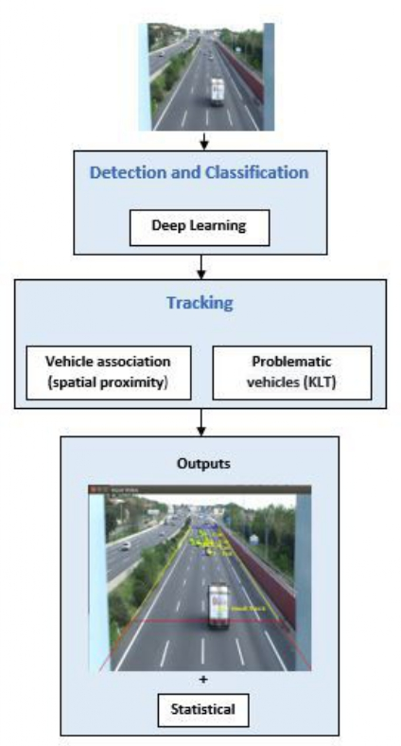
Monitoring and assessing traffic with deep learning
New dataset created (7 vehicle types).
Two modules:
Vehicle detection and classification.
Vehicle tracking.
1st module: YOLOv4.
2nd module: simple spatial association algorithm and more sophisticated KLT tracker to follow the vehicles.
Several experiments validated the system.

Slide 28
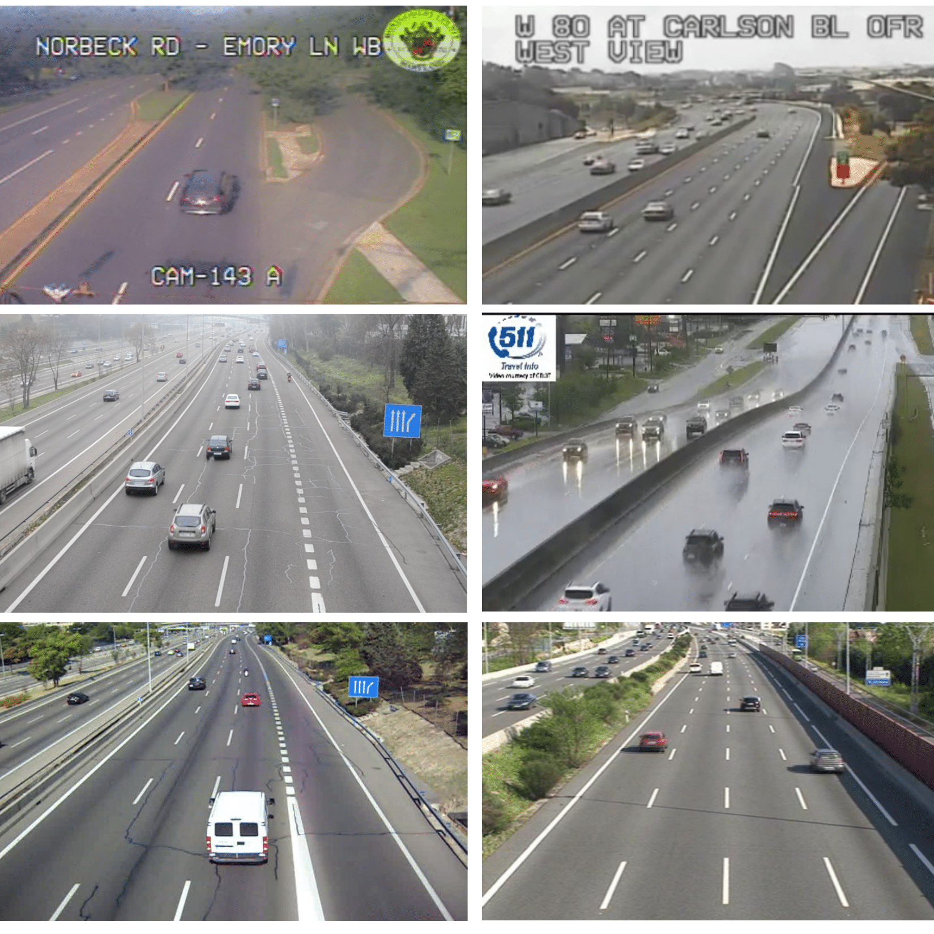
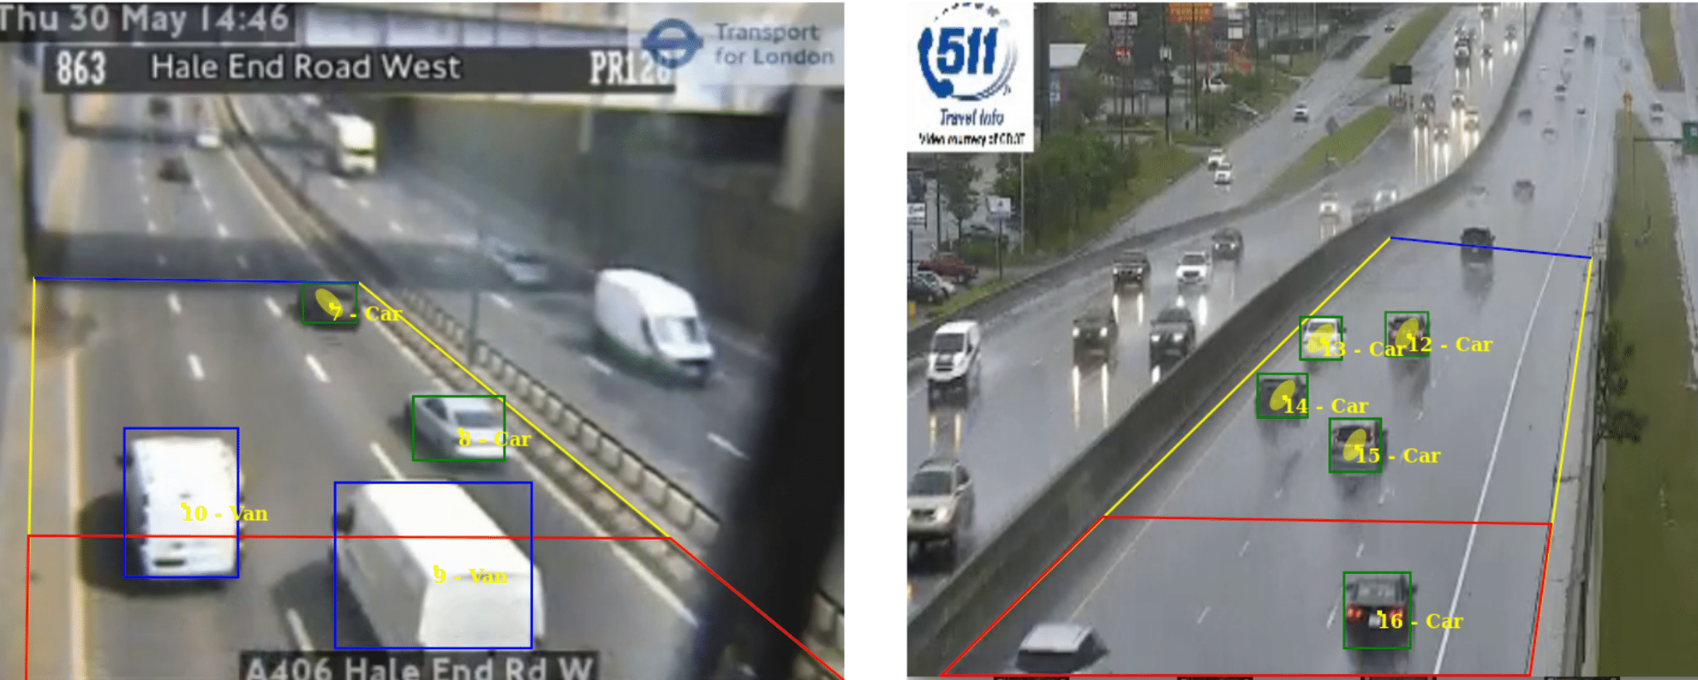
Experimental evaluation
System validated with a dataset of real traffic images.
Detection Metrics for comparing different object detection DL models (my contribution).
Dataset (~10000 examples):
Good weather conditions.
Bad weather conditions.
Poor-quality images.

Slide 29
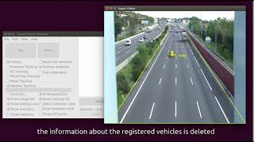
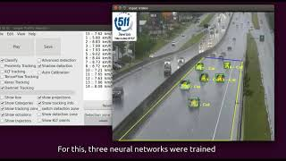
Conclusions
TrafficSensor is a solution for vehicle surveillance using deep learning. 7 classes.
Different DL models were studied and tested.
A new dataset was curated for this application.
The application proves to be robust to bad weather conditions, and blurred or low-resolution traffic images.
State-of-the-art enhancements.

Slide 30
DetectionMetrics

Slide 31
Assessing object detection deep learning architectures with quantitative metrics
Detection Metrics.
Comparison tool for the objective assessment of object detection approaches.
Open-source.
S. Paniego, V. Sharma, and J. M. Cañas, “Open source assessment of deep learning visual object detection,” Sensors, vol. 22, no. 12, 2022. doi: 10.3390/s22124575. [Online]. Available: https://www.mdpi.com/1424-8220/22/12/4575

Slide 32
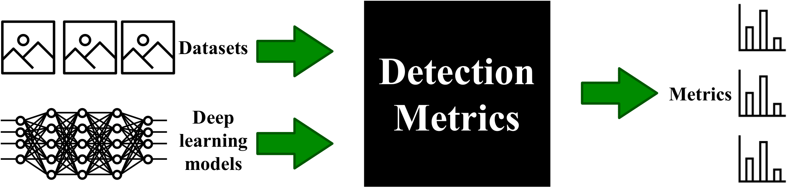
Introduction
Objective performance metrics.
Systematic evaluation of different DL models for object detection on large datasets.
Broad range of applicability: traffic monitoring, autonomous driving perception…
Suite of tools with unique features to facilitate the objective comparison of different DL models for object detection.

Slide 33


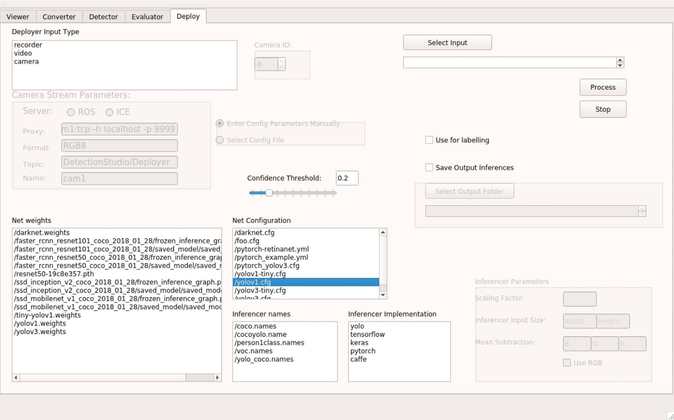
Detection Metrics tool kit
DL frameworks support.
Object detection datasets support.
It can be used as a ROS Node.
Two workflows:
Headless.
Graphical.
Main tools:
Detection generation.
Evaluation of detections with objective metrics.
Live detection visualization.
Dataset converter.

Slide 34
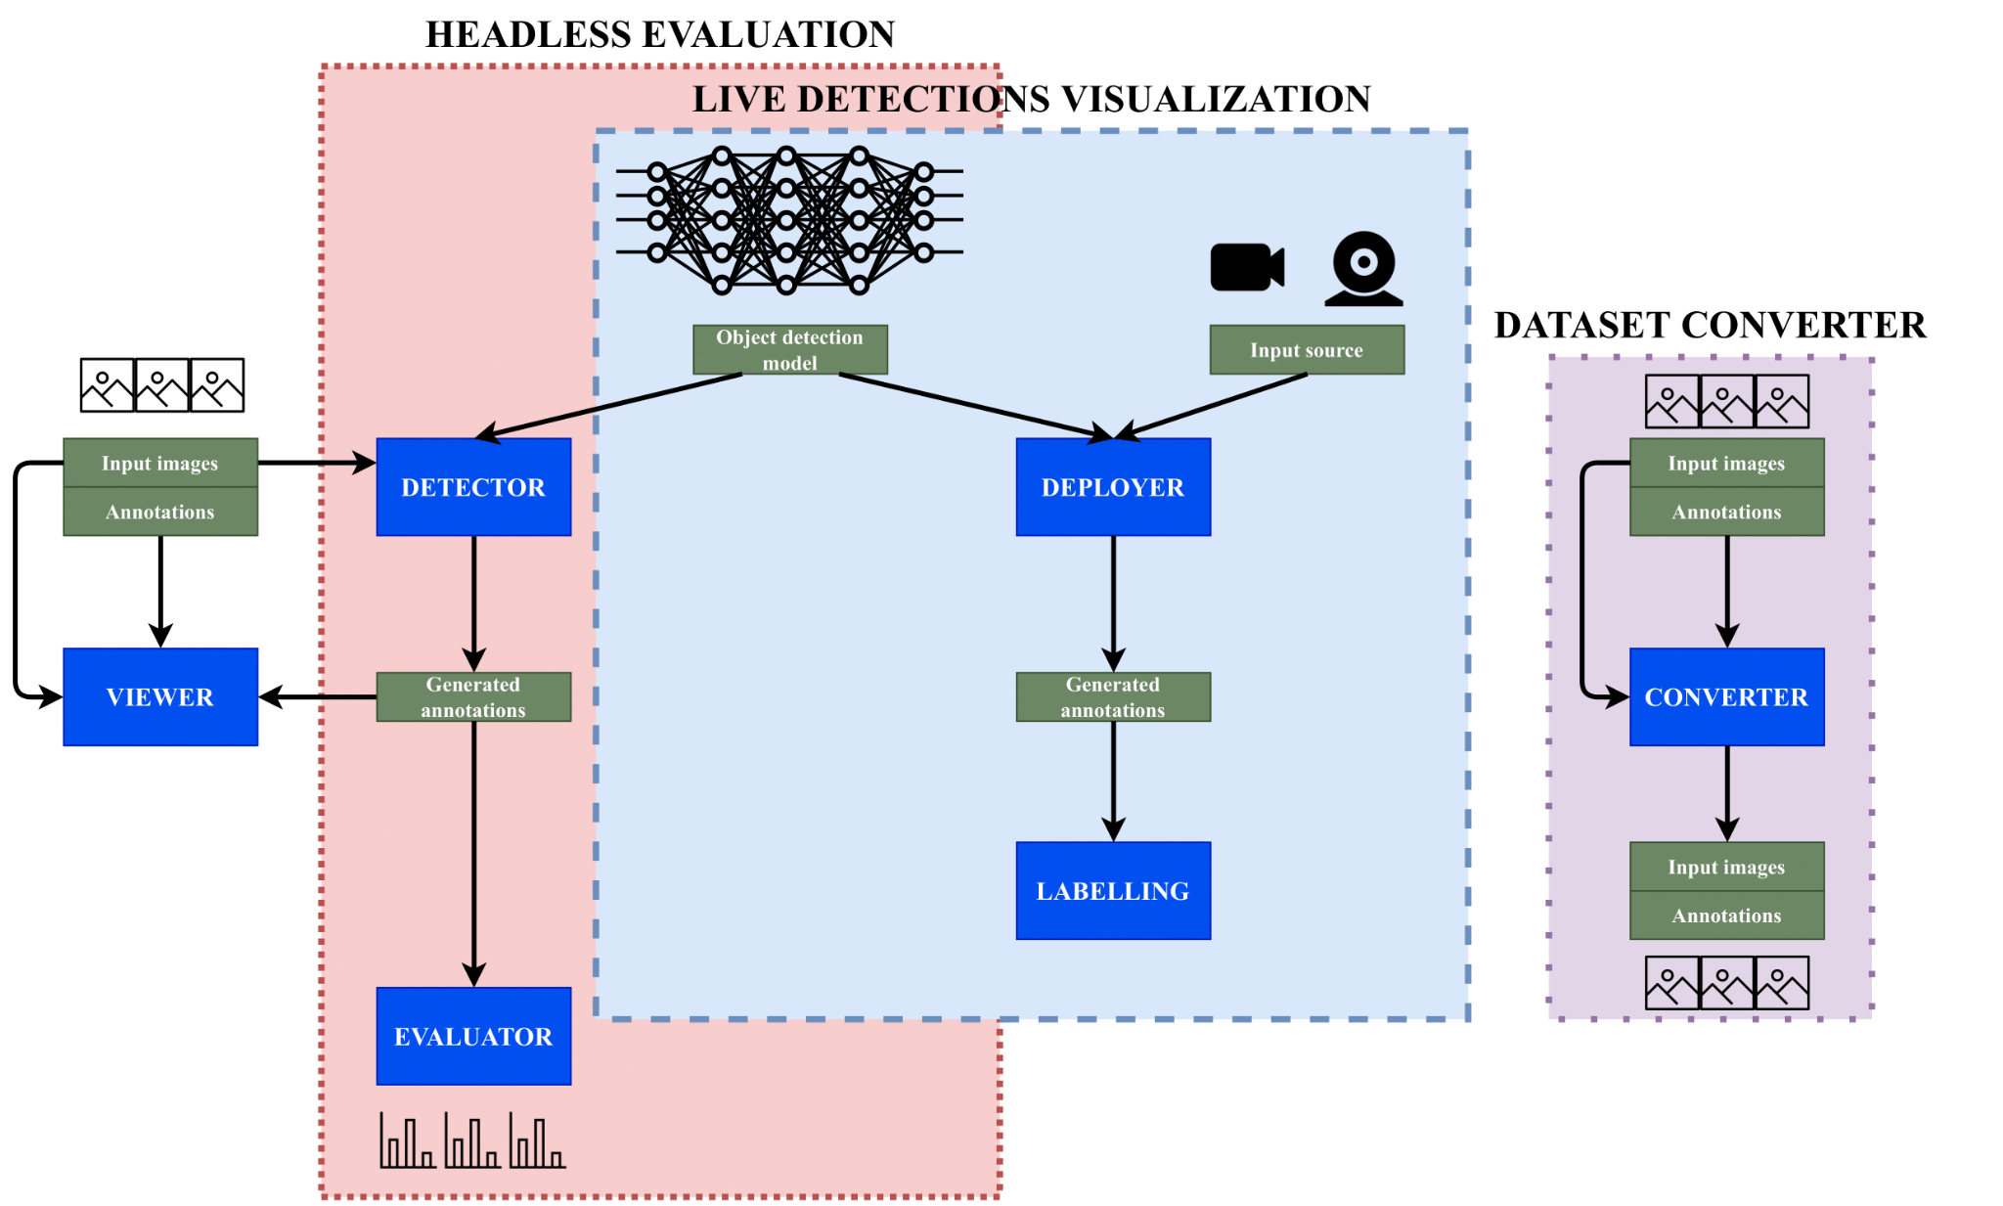
Detection Metrics tool kit

Slide 35
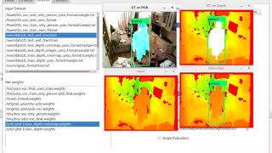
Detection Metrics tool kit

Slide 36
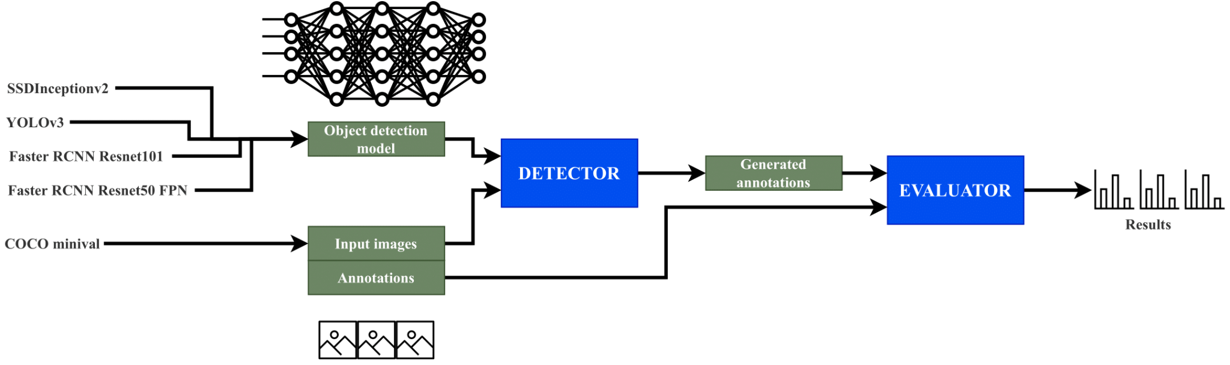
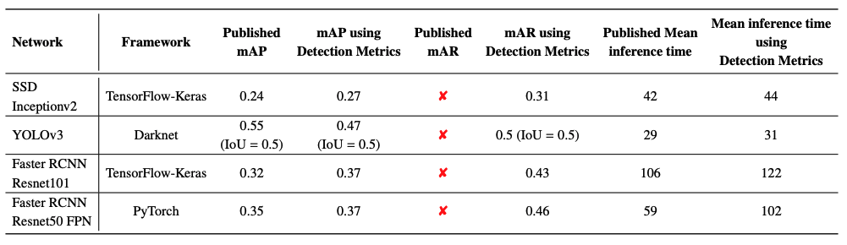
Experimental results and discussion
Used in TrafficSensor validation.
Comparison of state-of-the-art detection networks.

Slide 37
Conclusions
DetectionMetrics: open source assessment tool for developing object detection solutions validated in several experiments.
State-of-the-art enhancements.

Slide 38
Behavior Metrics

Slide 39
Assessing autonomous driving behaviors fine-grained metrics
Behavior Metrics is an open-source software tool developed to help research in the autonomous driving field.
The development and validation of autonomous driving solutions require testing broadly in simulation (online).
Quantitative and qualitative assessment and comparison of solutions for the main autonomous driving tasks.
S. Paniego, R. Calvo-Palomino, and J. Cañas, "Behavior Metrics: An Open-Source Assessment Tool for Autonomous Driving Tasks," Software X, vol. 26, pp. 101702, 2024 doi: 10.1016/j.softx.2024.101702. [Online]. Available: https://doi.org/10.1016/j.softx.2024.101702

Slide 40



Assessing autonomous driving behaviors fine-grained metrics
Two main evaluation pipelines:
Graphical.
Headless.
Generates quantitative metrics complementary to the simulator’s, including fine-grained metrics for each particular driving task (lane following, driving in traffic, route navigation…).
It uses and supports Carla, ROS, PyTorch and Tensorflow.

Slide 41
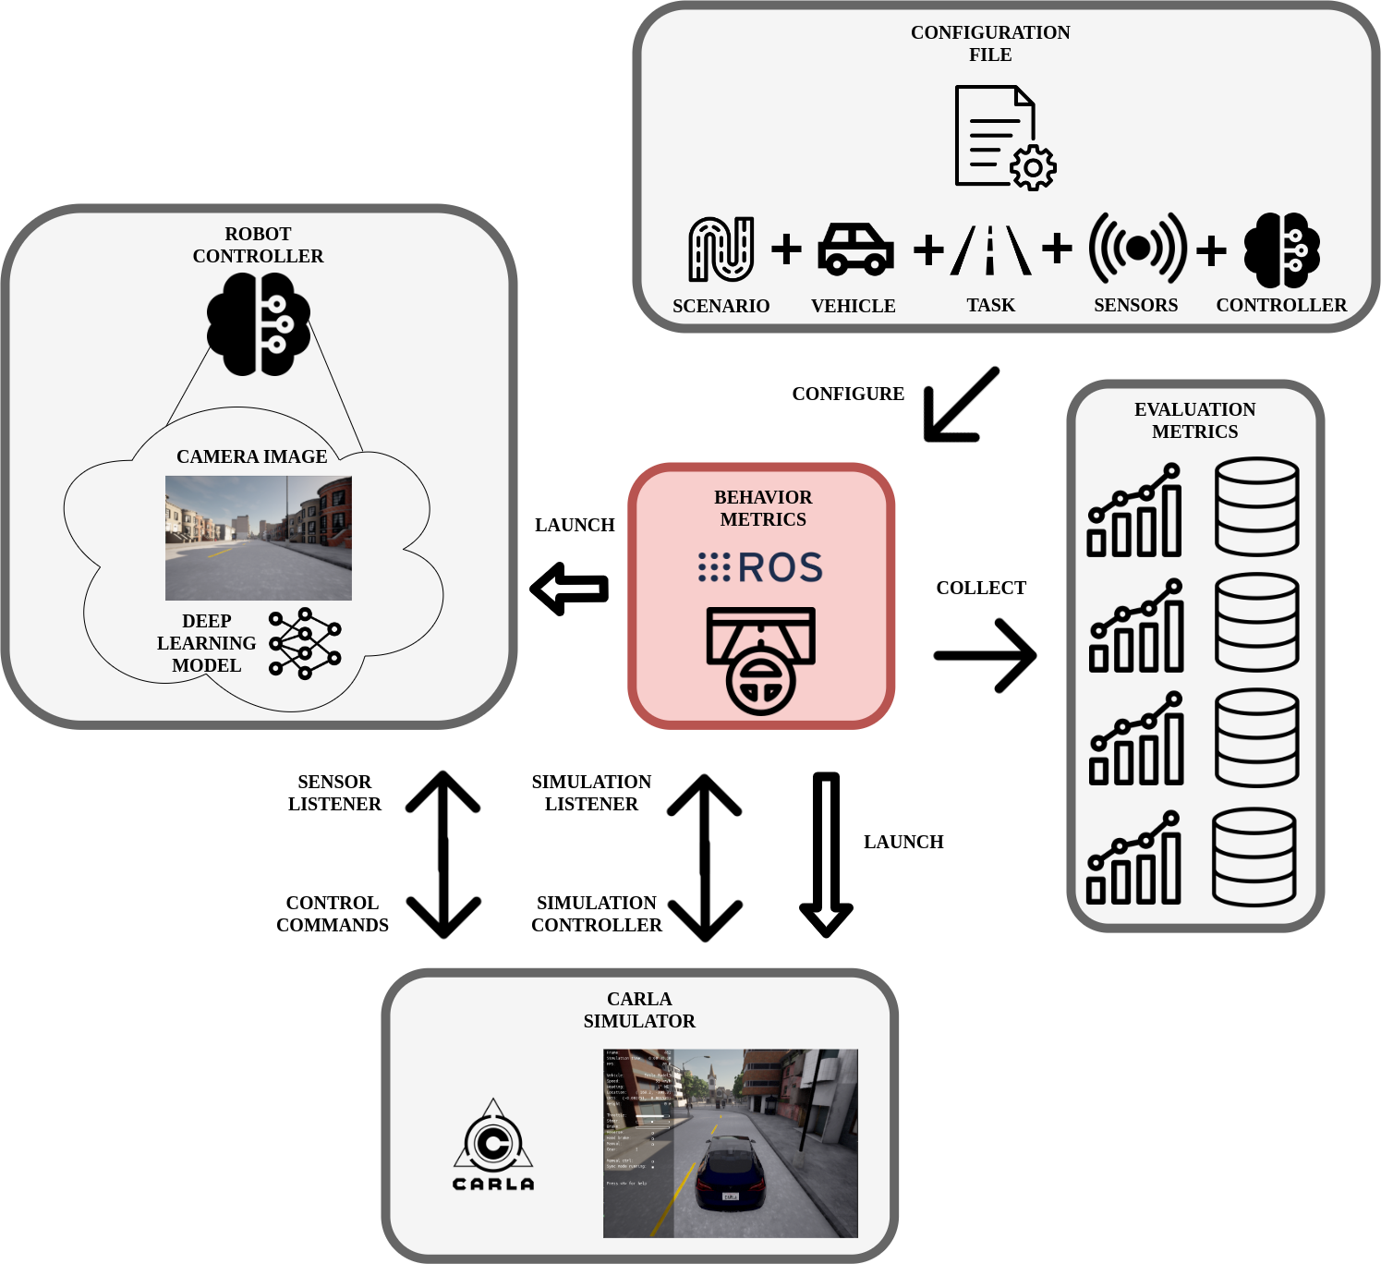
Assessing autonomous driving behaviors fine-grained metrics

Slide 42
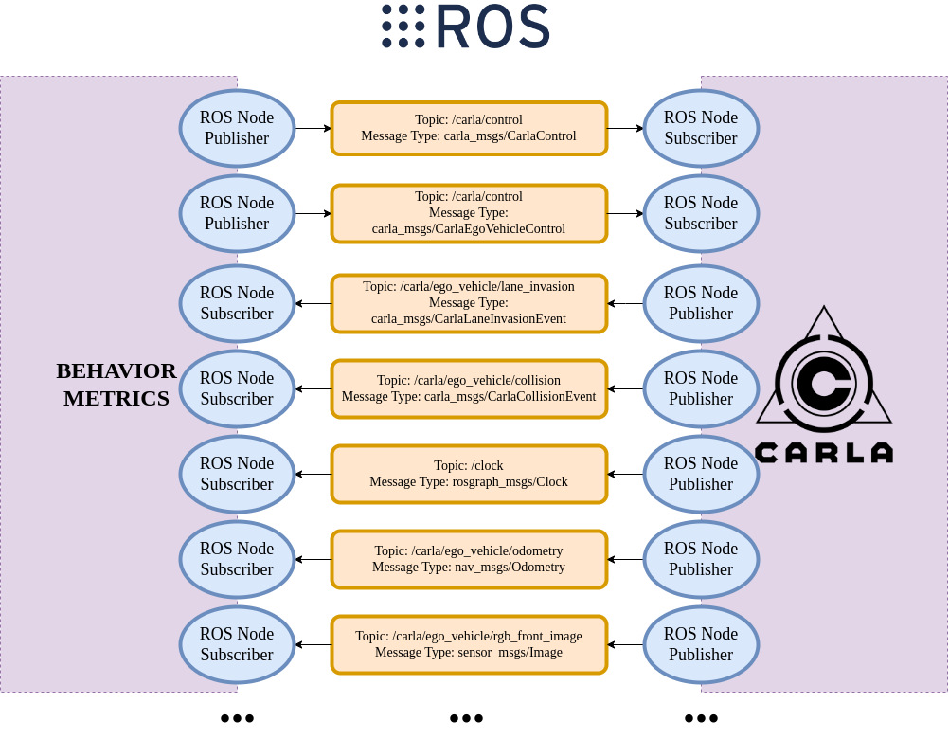
Connection between BM and CARLA

Slide 43
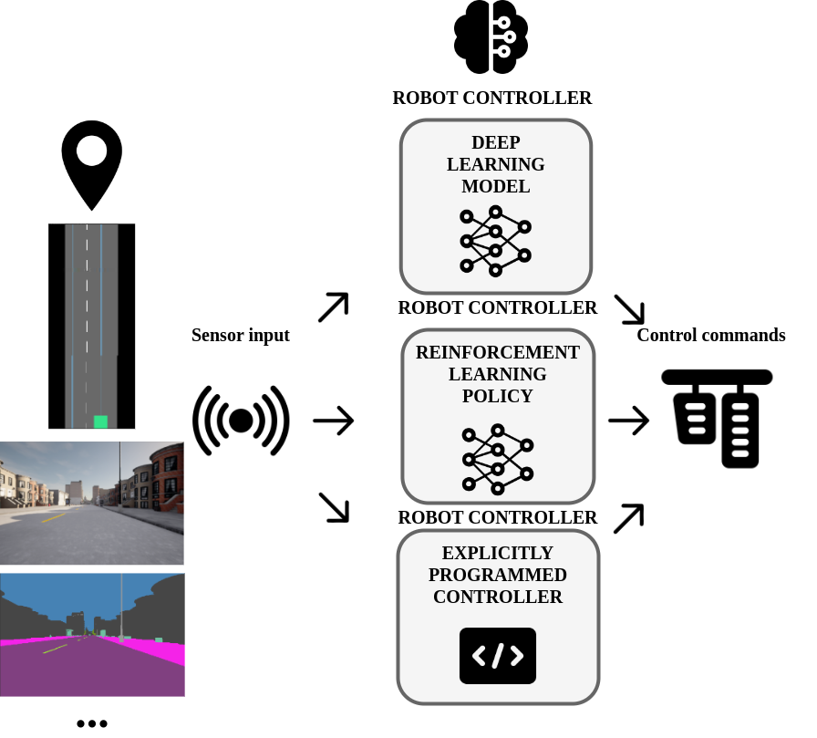
Robot controller

Slide 44



Supported tasks
It currently supports three main tasks:
Lane following.
Driving in traffic.
Point-to-point navigation.

Slide 45
Autonomous driving evaluation metrics
The proposed metrics are complementary to the simulator metrics (CARLA Leaderboard) and specific for each particular task:
Mean position deviation per km (MPD).
Effectively completed distance.
Vehicle longitudinal jerk per km.
Robot controller iteration frequency.
GPU inference frequency.
Collisions per km.
Lane invasions per km.
Distance to the front vehicle.
Route completion percentage.
Average speed.
Successful experiments.
…

Slide 46
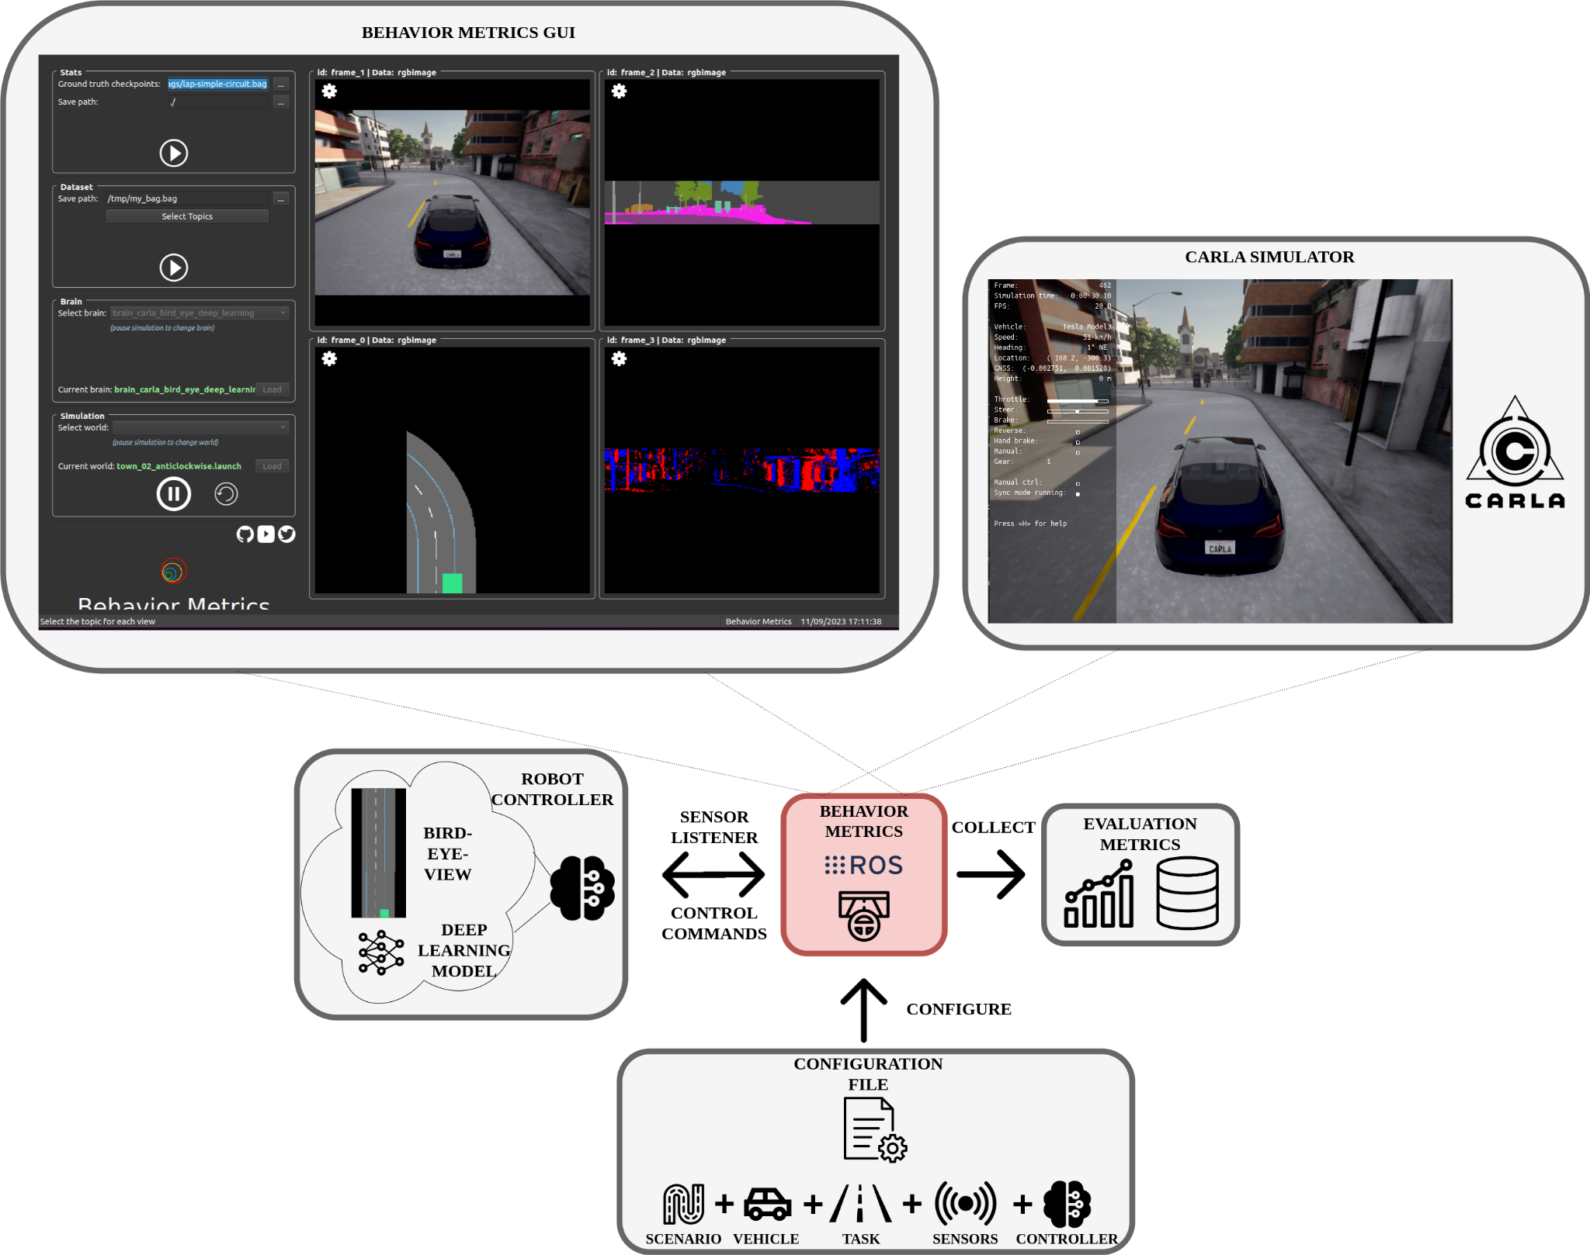
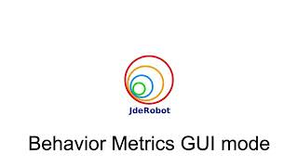
GUI evaluation mode

Slide 47
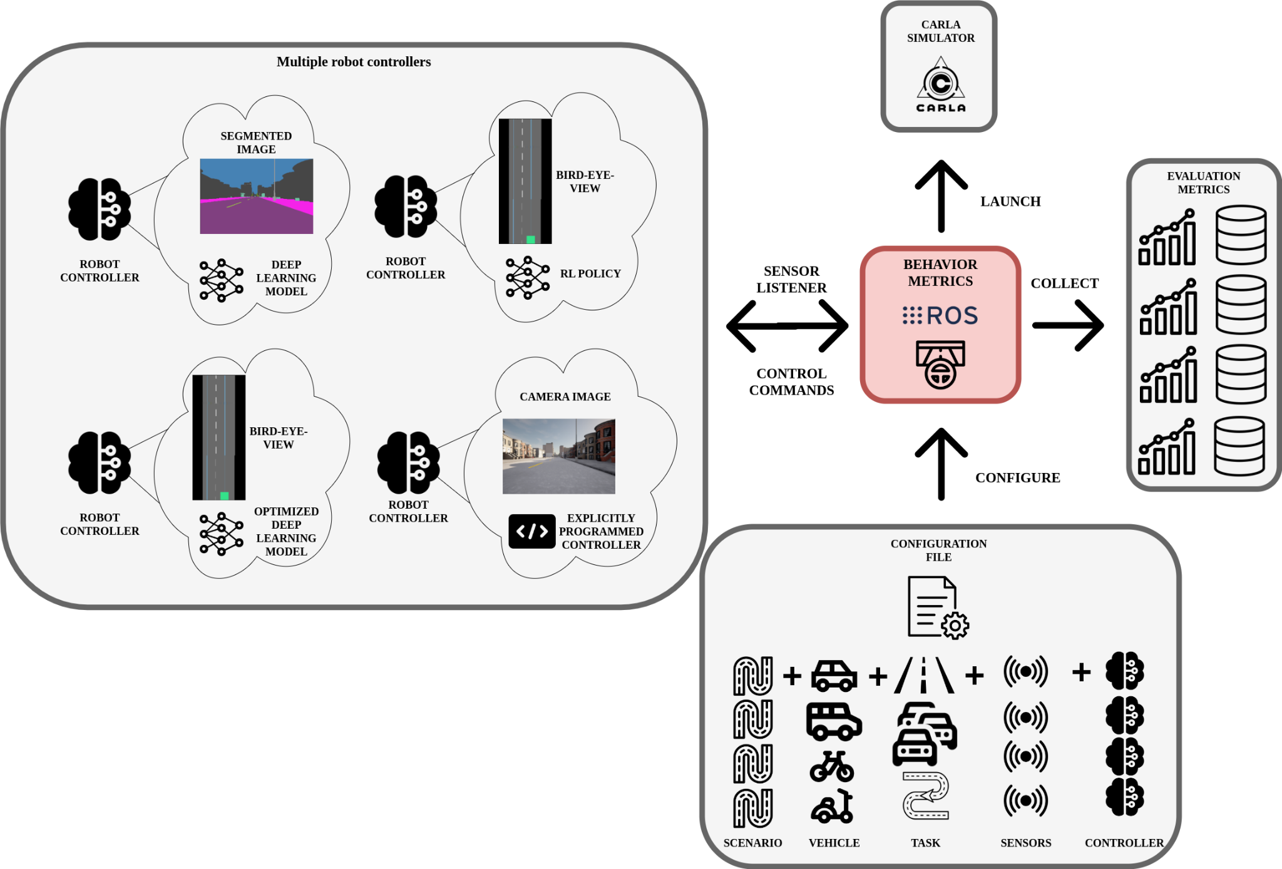
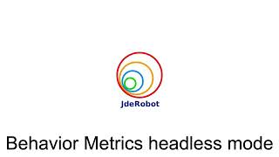
Headless evaluation mode

Slide 48
Impact and conclusions
Used as an assessment tool in this thesis.
There is a need for specialized assessment tool in autonomous driving for easy extraction of conclusions from experiments using fine-grained metrics.
Open-source.

Slide 49
Adding memory

Slide 50
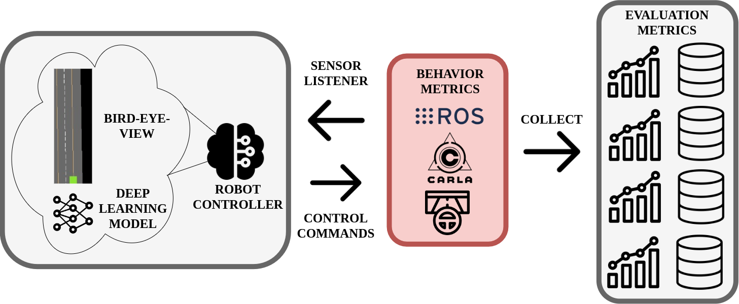
Enhancing E2E AD control through kinematic input and memory-based architectures
Explored and compared various approaches to enhance the capabilities of an end-to-end system for autonomous driving based on imitation learning adding visual memory and kinematic data input.
Offline and online evaluation (Behavior Metrics).
S. Paniego, R. Calvo-Palomino, and J. M. Cañas, “Enhancing End-to-End Control in Autonomous Driving through Kinematic-Infused and Visual Memory Imitation Learning,” Manuscript submitted for publication, 2024.

Slide 51
Enhancing E2E AD control through kinematic input and memory-based architectures
Lane-following application using different urban scenario layouts and visual bird-eye-view input.
Memory addition:
Architectural modifications.
Different types of sensory input.
Incorporating visual memory capabilities and kinematic input data: system more robust and able to handle a wider range of challenging situations (reduction of collisions and speed self-regulation).
LSTM, convLSTM…
Open source materials.

Slide 52
Introduction
We introduce and compare several DL architectural modifications that incorporate memory models and different sensory inputs to explore the potential benefits of different memory approaches in solving the problem of end-to-end AD through imitation learning.
We also explore the inclusion of kinematic data as input.
Hypothesis: adding visual memory capabilities and kinematic input data improves the quality of the generated robot control behavior in terms of the system’s robustness for never-seen situations and speed self-regulation.

Slide 53
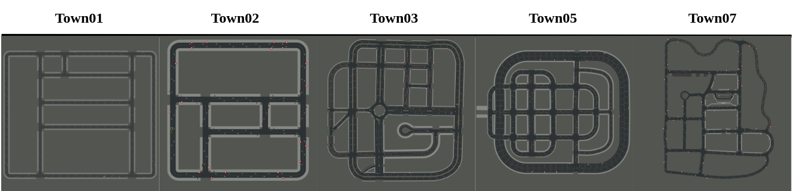
Kinematic-infused and visual memory E2E control based on imitation learning
8 DL models based on an E2E approach.
4 different DL architectures are explored:
One without memory.
Three with visual memory.
PilotNet (Bojarski et al. 2016).
Segmented bird-eye-view as input.
Expert agent data.

Slide 54
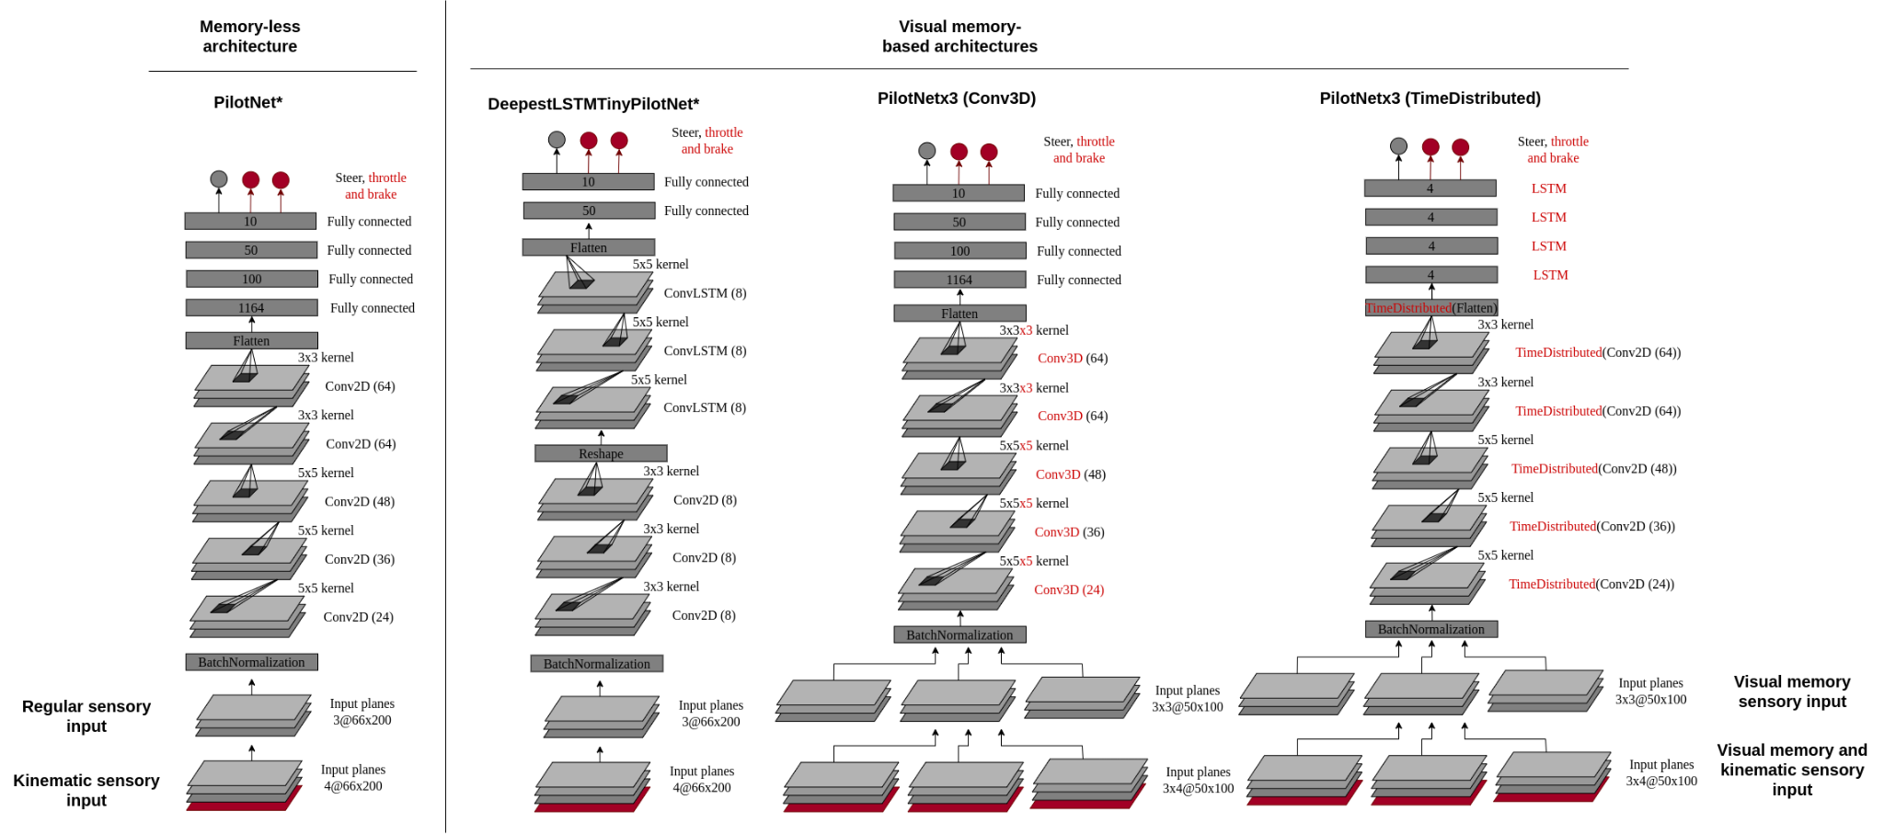
Kinematic-infused and visual memory E2E control based on imitation learning

Slide 55
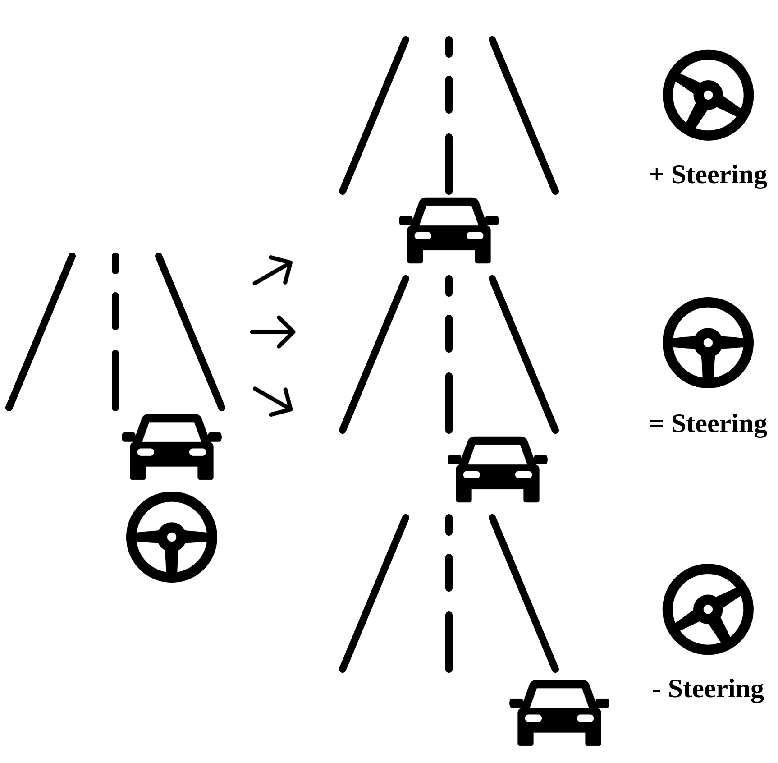
Kinematic-infused and visual memory E2E control based on imitation learning
Training:
20Hz for the collection.
Expert agent 30 km/h max.
Data augmentation. Affine is key.

Slide 56
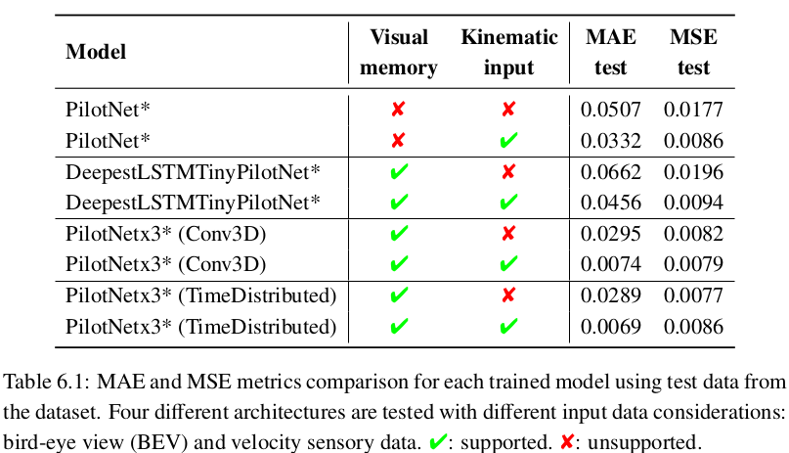
Experiment 1
Comparison of models using common ML metrics:

Slide 57
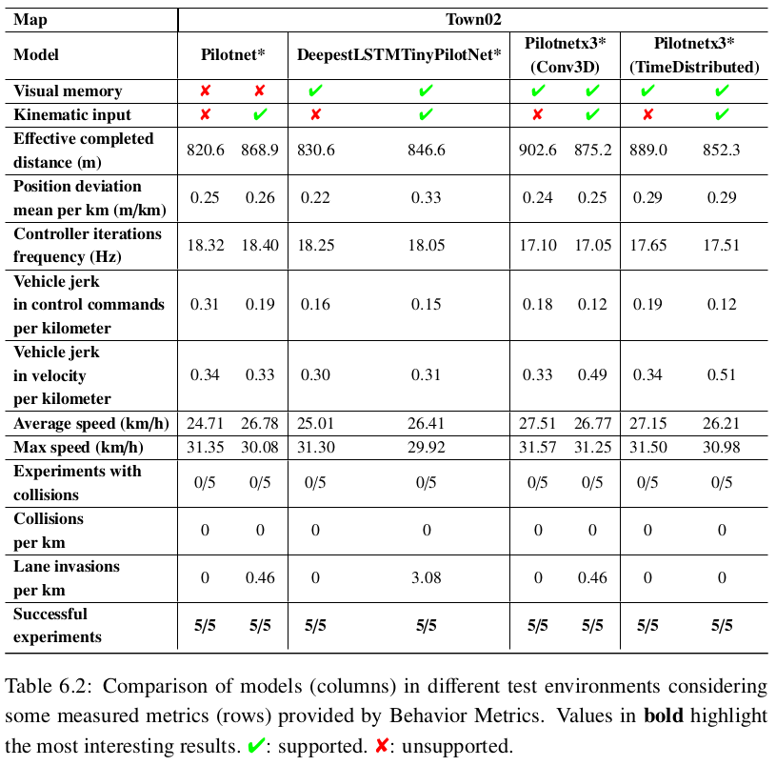
Experiment 2
Behavior in test scenario with top speed regulation

Slide 58
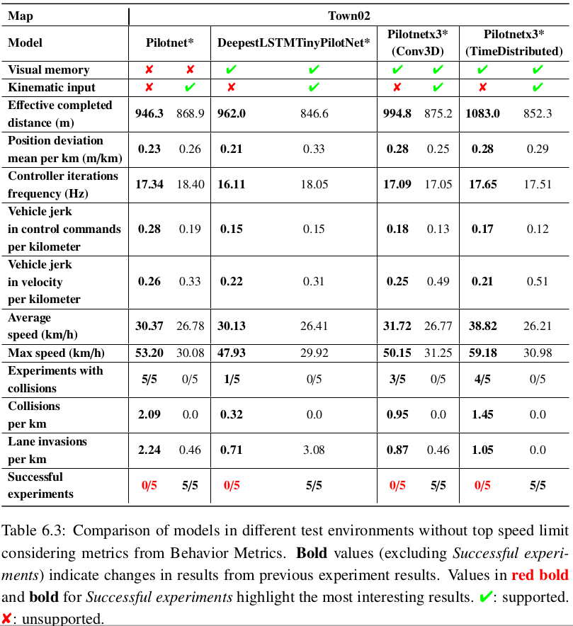
Experiment 3
Behavior in test scenario without top speed regulation

Slide 59
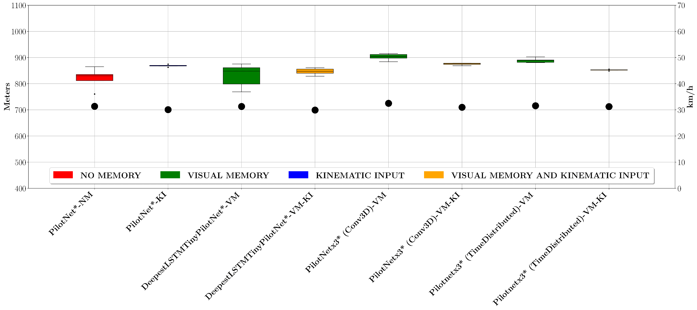

Top speed regulation vs no regulation

Slide 60



Taking control of a fast-moving car

Slide 61




Robustness to sensory manipulation
50%
90%

Slide 62


Visual memory length and density comparison

Slide 63

Conclusions
Adding visual memory and kinematic input data to the models enhances the quality of the final control behavior for following the lane.
Adding kinematic data, the system controls the speed better.
Combining it with visual memory, the vehicle increases its range of application.

Slide 64
Optimizing DL models

Slide 65

Optimization of end-to-end autonomous driving control
We explore and compare a variety of alternatives for model optimization in the context of E2E imitation learning autonomous driving.
Performance depends on quality of decisions and their frequency. Increase frequency without sacrificing decision quality.
Run deep learning robot-control application even in limited computed hardware.
Open source materials.
S. Paniego, N. Paliwal, and J. Cañas, “Model optimization in deep learning based robot control for autonomous driving,” IEEE Robotics and Automation Letters and IEEE International Conference on Robotics and Automation (ICRA), vol. 9, no. 1, pp. 715–722, 2024. doi: 10.1109/LRA.2023.3336244. [Online]. Available: https://doi.org/10.1109/LRA.2023.3336244

Slide 66
Optimization of end-to-end autonomous driving control
Trend towards E2E solutions.
DL models are high-demanding.
Available computing hardware is key for performance.
Some autonomous robots have high-performant hardware while others do not and is not always possible to upgrade (edge devices).
Optimization solution (framework support).

Slide 67

Optimizing E2E IL models for lane-follow robot control
The baseline architecture is based on PilotNet (Bojarski et al. 2016), named PilotNet*.

Slide 68
Optimizing E2E IL models for lane-follow robot control
Optimizations used:
Quantization (float16, int8).
Pruning.
Fine tuning (retraining).
Clustering.

Slide 69

Assessment of Models
Behavior Metrics.
In addition to the simulator's metrics:
Controller frequency.
GPU inference frequency.
Position deviation mean per km.
Successful runs.

Slide 70
Experiment 1: Offline evaluation
Model size reduction (12x int8 quantization).
GPU inference frequency improves.
135x TensorRT int8 quantization.
50x framework-specific int8 quantization.
Similar MSE.
Combination of optimizations generates best case: PCQAT (Sparsity and cluster preserving quantization aware training).

Slide 71

Experiment 2: Online evaluation
Higher controller frequency.
Faster models: int8 (47x TF, 2.3x PyTorch).
Similar mean position deviation and average speed.
Previous insights are applicable.
No decision quality degradation in online evaluation.
Faster and smaller models.
TF and PyTorch similar. TensorRT best.
Optimization limits require tuning.

Slide 72

Experiment 3: Inference freq. and Quality of Decisions in Robot Control Performance
Quality changes when the frequency of decisions is changed in the robot control.
Optimizing benefits control quality since in limited hardware, it may be critical to generate decisions above the turning point.

Slide 73
Conclusions
Optimizations improve the system performance (controller speed-up without losing decision quality).
Offline and online evaluation.
Optimized models have wider range of application (edge devices).
Combination of optimizations and hardware-specific optimizations generate the best models.

Slide 74
Driving in traffic

Slide 75
End-to-end vision-based autonomous driving in traffic
A shallow E2E vision-based DL approach for autonomous driving in traffic scenarios.
Goals: follow the lane and maintain a safe distance from possible preceding vehicles.
We prioritize simplicity of the model.
S. Paniego, E. Sinohara, and J. M. Cañas, “Autonomous Driving in Traffic with End-to-End Vision-based Deep Learning,” Neurocomputing, 2024. doi: 10.1016/j.neucom.2024.127874. [Online]. Available: https://www.sciencedirect.com/science/article/pii/S0925231224006453

Slide 76

Imitation learning for driving in traffic
Dataset extracted from expert agent behavior.
Traffic-0: does not consider traffic.
Traffic-1: includes one type of front vehicle.
Traffic-6: includes 5 other vehicles including vans and three urban cars of different sizes and colors.

Slide 77

Imitation learning for driving in traffic
2 models are variations of PilotNet (PilotNet* and PilotNet**).
We include oversampling during training.

Slide 78

End-to-end vision-based autonomous driving in traffic
We utilize activation heatmaps to understand where the models is paying attention during the decision making (Grad-CAM).

Slide 79

Experimental setup
We use Behavior Metrics for the online evaluation, including new specialized metrics (distance to vehicle).
With small changes to the architecture of PilotNet, it is possible to expand its application area widely.

Slide 80

Experiment 1: Execution without traffic
All the combinations of model+dataset works correctly. The model trained with Traffic-6 is better in MPD and Lane invasions.

Slide 81


Experiment 2: Execution with traffic
The model trained with Traffic-6 is better for all the metrics.

Slide 82


Experiment 3: generalization
The model trained with Traffic-6 generalizes for a whole set of vehicles

Slide 83

End-to-end vision-based autonomous driving in traffic

Slide 84
Conclusions
Proposal for safe autonomous driving in traffic scenarios following and E2E vision-based approach with imitation learning and deep learning.
The shallow models slightly changed can drive in traffic situations successfully as proved experimentally.
We also include a new metrics to Behavior Metrics.
TFM co-direction.

Slide 85
Conclusions and future research

Slide 86
Conclusions and future research
Make contributions in the field of vision-based autonomous driving using deep learning, imitation learning and end-to-end models.
Comprehensive literature review.
Solution for vehicle monitoring using deep learning.
Massive and unattended automatic assessment of DL visual object detection models solution.
Open source tool for the online assessment of AD systems.
Beyond achieving the basic follow lane, we explored the implications of the addition of visual memory and kinematic data to some apparently simple DL architectures.
Study the possibilities that optimization of DL add to the performance of the model and how they affect the final behavior.
Proposal for safe driving in traffic scenarios following an E2E vision-based approach with imitation learning and deep learning.

Slide 87
Research contributions
5 journal and conference papers:
S. Paniego, R. Calvo-Palomino, and J. Cañas, "Behavior Metrics: An Open-Source Assessment Tool for Autonomous Driving Tasks," Software X, vol. 26, pp. 101702, 2024 doi: 10.1016/j.softx.2024.101702. [Online]. Available: https://doi.org/10.1016/j.softx.2024.101702 [239]
S. Paniego, N. Paliwal, and J. Cañas, “Model optimization in deep learning based robot control for autonomous driving,” IEEE Robotics and Automation Letters and IEEE International Conference on Robotics and Automation (ICRA), vol. 9, no. 1, pp. 715–722, 2024. doi: 10.1109/LRA.2023.3336244. [Online]. Available: https://doi.org/10.1109/LRA.2023.3336244 [244]
S. Paniego, V. Sharma, and J. M. Cañas, “Open source assessment of deep learning visual object detection,” Sensors, vol. 22, no. 12, 2022. doi: 10.3390/s22124575. [Online]. Available: https://www.mdpi.com/1424-8220/22/12/4575 [234]
J. Fernández, J. M. Cañas, V. Fernández, and S. Paniego, “Robust real-time traffic surveillance with deep learning,” Computational Intelligence and Neuroscience, vol. 2021, p. 4 632 353, Dec. 2021. doi: 10.1155/2021/4632353. [Online]. Available: https://doi.org/10.1155/2021/4632353 [224]
S. Paniego, E. Sinohara, and J. M. Cañas, “Autonomous Driving in Traffic with End-to-End Vision-based Deep Learning,” Neurocomputing, 2024. doi: 10.1016/j.neucom.2024.127874. [Online]. Available: https://www.sciencedirect.com/science/article/pii/S0925231224006453

Slide 88
Research contributions
1 manuscript under peer-review:
Sergio Paniego, Roberto Calvo-Palomino, and José María Cañas, “Enhancing End-to-End Control in Autonomous Driving through Kinematic-Infused and Visual Memory Imitation Learning”.
1 preprint:
S. P. Blanco, S. Mahna, U. A. Mishra, and J. Canas, Memory based neural networks for end-to-end autonomous driving, 2022. arXiv: 2205.12124 [cs.RO]. [256]
1 workshop paper:
P. F. de Cabo, R. Lucas, I. Arranz, S. Paniego, and J. M. Cañas, “RL-studio: A tool for reinforcement learning methods in robotics,” in ROBOT2022: Fifth Iberian Robotics Conference, Springer International Publishing, Nov. 2022, pp. 502–513.doi: 10.1007/978-3-031-21062-4_41. [Online]. Available: https:// doi.org/10.1007%2F978-3-031-21062-4_41. [257]

Slide 89


Future (current) work 1
Point-to-point E2E navigation using input commands.
GSoC project.

Slide 90



Future (current) work 2
Transferring current E2E solutions to a real-world vehicle.

Slide 91
Future (current) work 3
E2E autonomous driving modulated with text-based instructions (LLMs).
GSoC project.

Slide 92



Future (current) work 4, 5, 6
Exploration of E2E autonomous driving in unstructured environments.
TFM co-direction.
Exploration of E2E autonomous driving in aerial vehicles.
Combination of driving experts.
TFG co-direction.

Slide 93
End-to-end Vision-based Autonomous Driving using Deep Learning
Author
Sergio Paniego Blanco
Supervisor
José María Cañas Plaza
Doctoral Program in Information and Communications Technologies
International Doctoral School
2024
@sergiopaniego
sergio.paniego@urjc.es
https://sergiopaniego.github.io/

Slide 96
End-to-end Vision-based Autonomous Driving using Deep Learning
Author
Sergio Paniego Blanco
Supervisor
José María Cañas Plaza
Doctoral Program in Information and Communications Technologies
International Doctoral School
2024
@sergiopaniego
sergio.paniego@urjc.es
https://sergiopaniego.github.io/

Slide 97
Curso de Inteligencia Artificial
Sergio Paniego Blanco
@sergiopaniego
sergio.paniego@urjc.es
https://sergiopaniego.github.io/
https://roboticslaburjc.github.io/
Escuela de Ingeniería de Fuenlabrada Teoría de la Señal y las Comunicaciones y Sistemas Telemáticos y Computación

Slide 98
Outline
Introducción a Python.

Slide 99

Web
https://roboticslaburjc.github.io/

